Slide 1




Slide 2

Autoencoding Language Models
Notes:
Hello and welcome, in this video we will start to dive into the components of the internal structure of transformers.

Slide 3
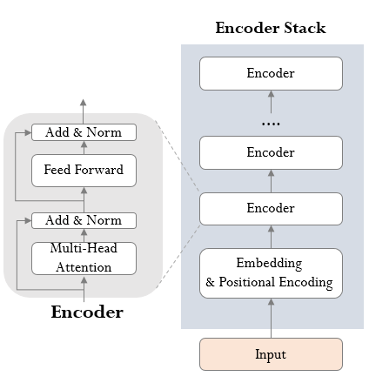
Introduction
Autoencoders are Encoder-only architecture.
Autoencoding models are pretrained by corrupting the input tokens and reconstructing the original sentence.
They correspond to the encoder of the original transformer model without any mask.
These models convert text sequences into numerical representations.
The representation of a token depends on both left and right contexts, known as bidirectional attention.
Autoencoders usually build a bidirectional representation of the entire sentence.

Slide 4
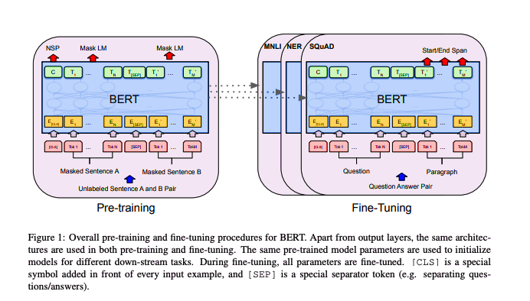
BERT (Bidirectional Encoder Representations from Transformers)
BERT (Bidirectional Encoder Representations from Transformers) is a famous example of an autoencoding model.
BERT utilizes the encoder Transformer stack with slight modifications for language modeling.
It has achieved state-of-the-art results on various natural language processing benchmarks.

Slide 5
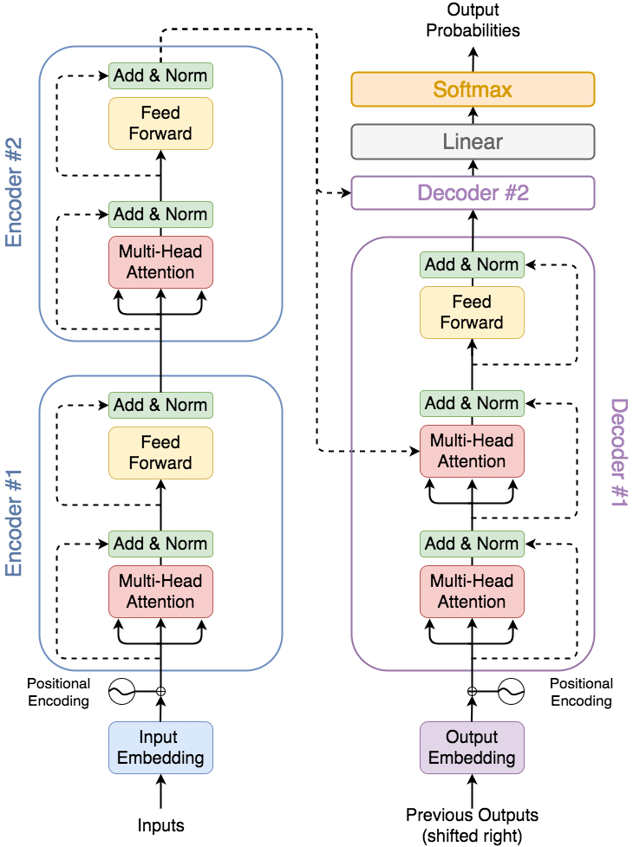
BERT (Bidirectional Encoder Representations from Transformers)
BERT is a multilayer Transformer encoder based on the original Transformer implementation.
The Transformer model was originally designed for machine translation tasks.
BERT is the utilization of encoder part of the architecture to provide better language modeling.
After pretraining, BERT provides a global understanding of the language it is trained on.

Slide 6
Objectives of BERT
Masked language modeling
Next sentence prediction.

Slide 7
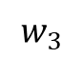
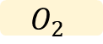
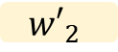

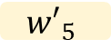
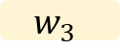
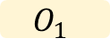
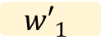
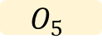

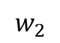
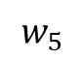
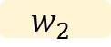
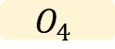
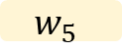
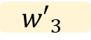
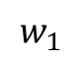
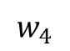
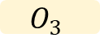
Masked language modeling (MLM)
The task of training a model on input which in this case is a sentence with some masked tokens .and obtaining the output as the whole sentence with the masked tokens filled.
$${w′}_{1}$$
$${w′}_{2}$$
$${w′}_{3}$$
$${w′}_{4}$$
$${w′}_{5}$$
Classification Layer: Fully-connected layer + GELU + Norm
$$O_{1}$$
$$O_{2}$$
$$O_{3}$$
$$O_{4}$$
$$O_{5}$$
BERT
Embedding
$$w_{1}$$
$$w_{2}$$
$$w_{3}$$
[MASK]
$$w_{5}$$
$$w_{1}$$
$$w_{2}$$
$$w_{3}$$
$$w_{4}$$
$$w_{5}$$

Slide 8
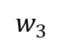
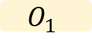
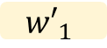
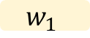
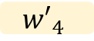
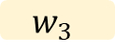
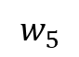
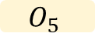
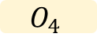
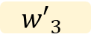
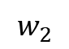
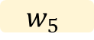
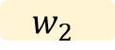
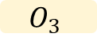
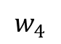
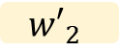
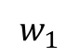
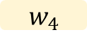
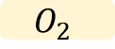

Masked language modeling (MLM)
15% of the words in each sequence are replaced with a MASK token.
The model then attempts to predict the original words of the masked words, based on the context provided by the other non masked words in the sequence.
Adding a classification layer on top of the encoder output. Which is a fully connected layer.
Multiplying the output vectors by the embedding matrix, transforming them into the vocabulary dimension.
Calculating the probability of each word in the vocabulary using SoftMax.
Note: that BERT loss function takes into consideration only the prediction of the masked values and ignores the prediction of the non masked words.
$${w′}_{1}$$
$${w′}_{2}$$
$${w′}_{3}$$
$${w′}_{4}$$
$${w′}_{5}$$
Classification Layer: Fully-connected layer + GELU + Norm
$$O_{1}$$
$$O_{2}$$
$$O_{3}$$
$$O_{4}$$
$$O_{5}$$
BERT
Embedding
$$w_{2}$$
$$w_{3}$$
$$w_{4}$$
$$w_{5}$$
$$w_{1}$$
[MASK]
$$w_{1}$$
$$w_{2}$$
$$w_{3}$$
$$w_{4}$$
$$w_{5}$$

Slide 9

How and why does Masked language modeling help a model to obtain better results on downstream tasks such as classification?.

Slide 10
Masked language modeling (MLM)
if the model can do a cloze test which is a linguistic test for evaluating language understanding by filling in blanks. then it has a general understanding of the language itself.
Cloze test example:
The cat slept on the [mask]. It likes sleeping all day.
For a masked language model, the same task is applied, and it is required to fill in the masked tokens. However, masked tokens are selected randomly from a sentence.
rug

Slide 11
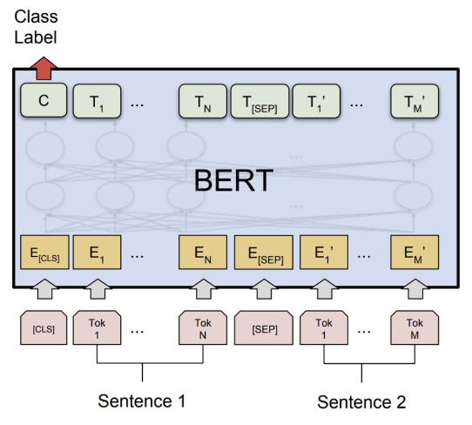
Next Sentence Prediction (NSP)
NSP ensures that BERT learns not only the relations of all tokens to each other in predicting masked ones. but also helps it understand the relation between two sentences
A pair of sentences is selected and given to BERT with a separation splitter token in between. It is also known from the dataset whether the second sentence comes after the first one or not.
The input contains the two sentences. two new tokens were added:
Binary classification token [CLS] is added to the beginning of
the first sequence to predict if the second sequence follows the
first one.
Separation token that indicates the end of a sequence.

Slide 12
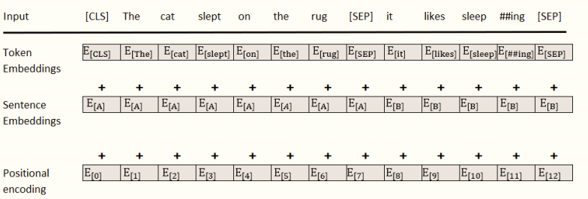
Next Sentence Prediction (NSP)
For Example:
The cat slept on the rug. It likes sleeping all day.
This approach requires additional encoding information to distinguish sequence A from sequence B .
Add sentence embeddings to token embeddings with positional encoding.
[CLS] the cat slept on the rug [SEP] it likes sleep ##ing all day [SEP]

Slide 13
Next Sentence Prediction (NSP)
1%
B not follow A
Determine how likely the second sentence follows the first:
pass the input embeddings of the whole input sequence through the encoder model.
apply a simple classification layer to the output of the [CLS] token and gets a vector of shape 2×1.
compute the probability of likelihood that sentence B belongs after sentence A using SoftMax.
When training the BERT model, MLM and NSP are trained together, with the goal of minimizing the combined loss function of the two methods.
BERT uses bidirectional attention in all its multi-head attention sub-layers, opening vast horizons of learning and understanding relationships between tokens.
99%
B follow A
FNN + SoftMax
…
512
BERT
…
512

Slide 14
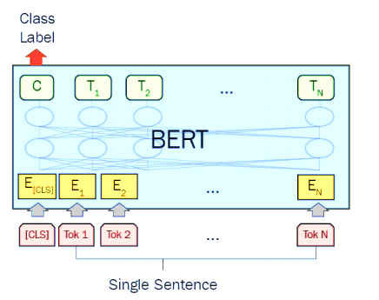
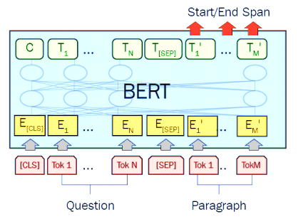
Fine tune Bert for downstream tasks
Classification tasks like sentiment analysis.
Adds a classification layer on top of the model output for the [CLS] token, similar to how it does Next Sentence prediction.
Question Answering tasks gets a question and a text sequence or paragraph and has to mark the answer in the sequence.
learns two extra vectors that show where the answer starts and ends.

Slide 15
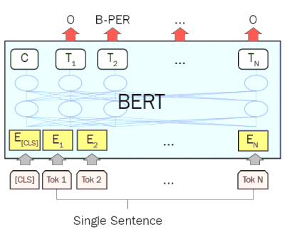
Fine tune Bert for downstream tasks
Named Entity Recognition gets a text sequence and has to mark the different kinds of entities in the text like Person, Organization, Date, etc.
feeds the output vector of each token into a classification layer that guesses the Named Entity label.

Slide 16


